Slide 1
Stock Data Analysis & ETL Pipeline
Transforming Raw Stock Market Data into Actionable Business Insights through an End-to-End Analytics Pipeline
Stock Data
ETL Layer
Analytics

Slide 2
Project Overview
OBJECTIVE
The Stock Market Data Analytics Pipeline is designed to automate the collection, processing, analysis, and visualization of historical stock market data. The project integrates Python, Yahoo Finance API, SQL Server, and Power BI to build a centralized analytics solution that transforms raw market data into meaningful business insights.
The pipeline performs data extraction, cleaning, validation, storage, SQL-based analysis, and interactive dashboard visualization, enabling users to monitor stock performance, identify market trends, and support data-driven investment decisions.
Technology Stack
Data Source: Yahoo Finance API
Programming: Python (Pandas, NumPy, yFinance)
Database: SQL Server
Query Language: SQL
Visualization: Power BI
2

Slide 3
CHANLLENGES AND STARTEGIC SOLUTION
Stock data arrives from multiple sources with inconsistent formats, missing values, and different timestamps.
Manual cleaning slows analysis and creates avoidable errors in reporting and downstream modeling.
Without a controlled ETL process, data quality issues can silently distort trend analysis and business decisions.
Business Problem
Investors, analysts, and financial institutions rely on accurate historical stock market data to evaluate company performance and make informed investment decisions. However, market data is often spread across multiple sources and requires significant manual effort to collect, clean, and analyze.
).
Challenge | Solution
Manual data collection | Automated data extraction using Python
Disorganized datasets | Centralized SQL Server database
Slow performance analysis | Optimized SQL analytical queries
Limited reporting capabilities | Interactive Power BI dashboards
Difficulty identifying market trends | Automated trend and performance analysis
Data quality issues | Cleaning, validation, and standardization using Pandas
3

Slide 4
High-Level Architecture And Component Architecture
Data Source Layer
┌─────────────────────────┐
│ Yahoo Finance API │
└────────────┬────────────┘
│
▼
Data Acquisition Layer
┌─────────────────────────┐
│ Python + yfinance │
└────────────┬────────────┘
│
▼
Data Processing Layer
┌─────────────────────────┐
│ Pandas │
│ Data Cleaning │
│ Feature Engineering │
└────────────┬────────────┘
│
▼
Data Storage Layer
┌─────────────────────────┐
│ SQL Server │
│ stock_data_2024 │
└────────────┬────────────┘
│
▼
Analytics Layer
┌─────────────────────────┐
│ SQL Queries │
│ Window Functions │
│ Aggregations │
└────────────┬────────────┘
│
▼
Visualization Layer
┌─────────────────────────┐
│ Power BI Dashboard │
└─────────────────────────┘
Yahoo Finance API
│
(Historical Data)
│
▼
Python (yfinance Library)
│
▼
Pandas Data Processing
┌───────────────────────────────────┐
│ │
│ Remove Missing Values │
│ Handle Data Types │
│ Rename Columns │
│ Merge Multiple Stocks │
│ Feature Engineering │
└───────────────────────────────────┘
│
▼
stock_data_2024.csv
│
▼
SQL Server Database
│
▼
SQL Queries & Aggregations
│
▼
Power BI Interactive Dashboard
│
▼
Business Decision Support
4

Slide 5
ETL Workflow
From ingestion to analytics-ready data
Extract from source systems and land raw files in a staging zone.
Standardize schema, timestamps, and field Yahoo Finance API
│
▼
Extract Historical Data
(Python + yFinance) │
▼
Raw Dataset Collection
(CSV Data Storage)
│
▼
Data Cleaning & Validation
(Python + Pandas)
│
▼
Data Transformation
• Standardize Data Types
• Handle Missing Values
• Remove Duplicates
• Format Date Columns
• Calculate Daily Returns
• Create Moving Averages
│
▼
Load into SQL Server
(Analytics Database)
SQL.
▼
SQL Data Analysis
• Aggregations
• Window Functions
• Performance Metrics
│
▼
Power BI Dashboard
│
▼
Business Insights &
Decision Supportnaming conventions.
Run row-level checks, null checks, duplicate checks, and range checks.
Transform into normalized fact and dimension tables for reporting and analysis.
Load curated tables into the analytics layer for dashboards and ad hoc
6

Slide 6
Validation and Data Quality Controls
Validation Type | Quality Check | Purpose
Schema Validation | Verify columns and data types | Ensure correct data structure
Completeness Check | Detect NULL or missing values | Prevent incomplete records
Duplicate Validation | Check unique Stock + Date records | Eliminate duplicate entries
Accuracy Validation | Validate OHLC prices and volume | Ensure business rule compliance
Consistency Check | Standardize formats and stock names | Maintain data uniformity
Range Validation | Detect negative prices or invalid dates | Identify abnormal values
Transformation Validation | Verify cleaned and derived data | Ensure correct data processing
Load Validation | Compare source vs. target records | Confirm successful data loading
9

Slide 7
Testing Strategy and SQL Scenarios
SQL Test Scenario | Validation Performed
Record Count Validation | Verify source and target row counts match after loading.
Duplicate Record Check | Ensure each Stock + Date combination is unique.
NULL Value Validation | Check mandatory columns for missing or NULL values.
Price Validation | Verify OHLC values follow valid market rules (High ≥ Low, etc.).
Volume Validation | Ensure trading volume contains only valid positive values.
Aggregation Validation | Validate SQL calculations such as AVG, SUM, MIN, MAX, and COUNT.
Date Validation | Verify trading dates are valid and correctly ordered.
Business Rule Validation | Validate calculated metrics such as Daily Return and Moving Average.
Testing Strategy | Description
Unit Testing | Validate each data extraction, cleaning, and transformation step independently.
Source-to-Target Reconciliation | Compare source and target row counts to ensure complete data loading.
Data Quality Testing | Validate null values, data types, ranges, and business rules for critical fields.
Integration Testing | Verify end-to-end data flow from Yahoo Finance API → Python → SQL Server → Power BI.
Regression Testing | Ensure new updates or data refreshes do not affect existing functionality.
Smoke Testing | Perform basic validation after every refresh to confirm pipeline stability.
10

Slide 8
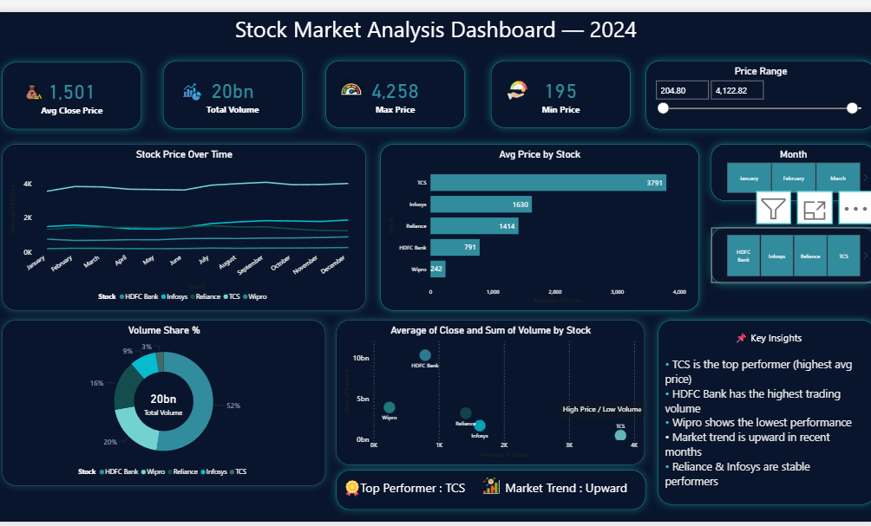
12

Slide 9
Business Insights
Business Insights
TCS emerged as the top-performing stock, recording the highest average closing price (3,791), indicating strong market performance throughout 2024.
HDFC Bank contributed the highest trading volume, accounting for nearly 52% of the total traded volume (20 Billion), reflecting high market liquidity and investor participation.
Wipro recorded the lowest average closing price (242), making it the weakest performer among the selected stocks.
The overall market showed an upward trend during the second half of 2024, indicating improving investor confidence and positive market momentum.
Reliance and Infosys maintained relatively stable price movements, making them suitable choices for balanced investment portfolios.
TCS achieved high stock prices despite comparatively lower trading volume, demonstrating strong investor confidence and sustained demand.
The dashboard enables easy comparison of stock prices, trading volume, and performance trends, allowing users to quickly identify market leaders and underperforming stocks.
Monthly trend analysis highlights stronger market performance in recent months, supporting better timing for investment decisions.
11

